Slide 1


Progress Presentation
Team: 5G

Slide 2

List
table of contents
1
Frontend
2
Backend
ⓒSaebyeol Yu. Saebyeol’s PowerPoint

Slide 3
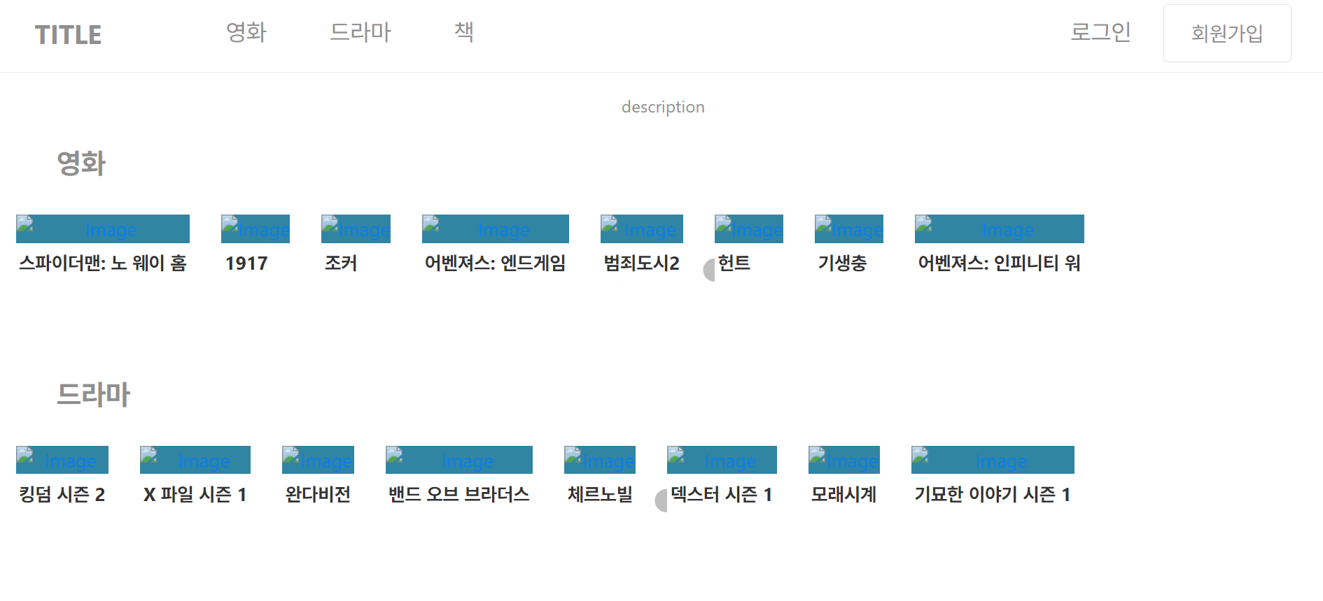
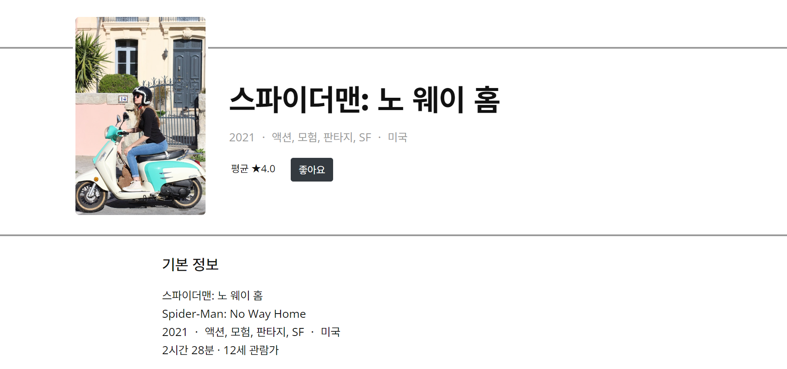
Frontend

Slide 4
Backend
- Search Engine
- extract keywords from db
- sentence BERT
Learn model when user register

Slide 5
Next week
update user's preference information when user hits '좋아요' (inside content page)
Search page

